Slide 1
Analyzing the NFL
Statistical Analysis of NFL league-wide data
Wyatt Marciniak
Pia Om
Laramie Regalado

Slide 2
(1) : Multivariate Regression Model
Objective: Attempt to create a prediction model for a team's winning percent
Methodology:
Aggregate variable data sets and create a null and full model using all variables
Use Stepwise() and all.poss.regs() to generate 2 new models per iteration
Check state of co-linearity and residuals’ plots at each step to aid in variable removal
PIck a final model and analyze the need to transform
Transform the predictors Accordingly
Compare and analyze the “best” model

Slide 3
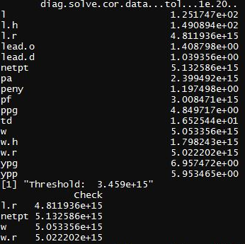

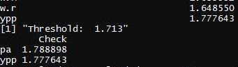

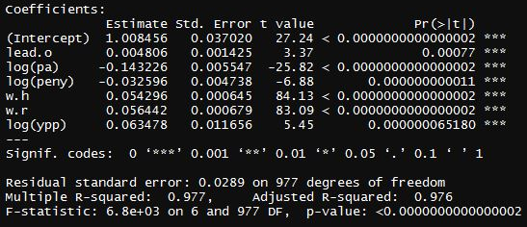
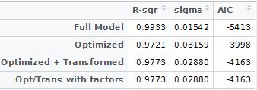

Slide 4
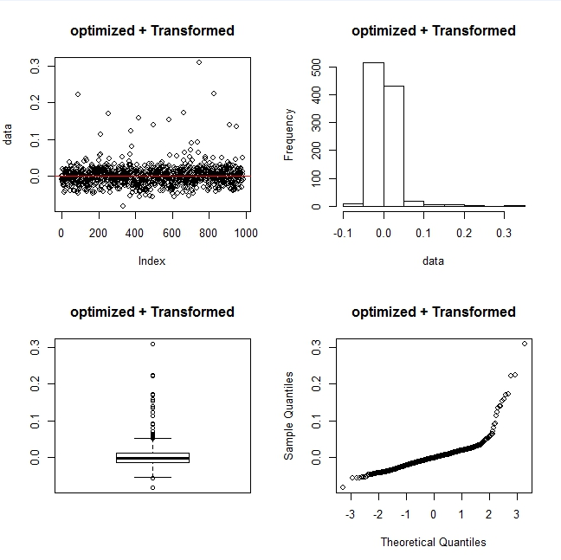
Notes:
But when tried to use as prediction model,
Initial analysis of data, realized this data was not granular

Slide 5
(2) : “Home Field Advantage”
Objective: Determine if there is a tendency for teams to win at home over the road
Methodology:
Use two tailed t-tests to assess if the difference in wins at home and the road is significant
Use one-tailed t-tests to support the analysis
What data we used:
Look at the individual team’s t-tests to see if there is a significant difference in the means
Look at the aggregate league data over multiple time frames to assess the significance of this theory across generations and rule changes

Slide 6
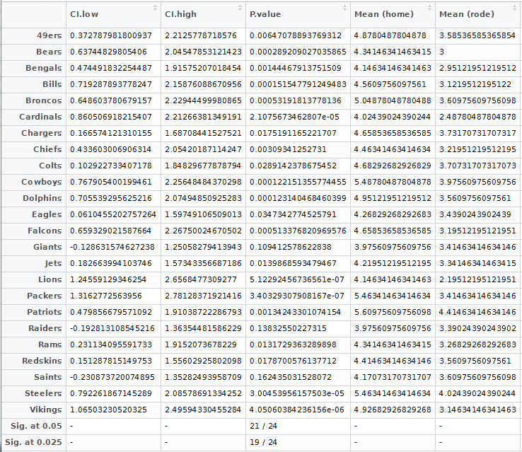

Slide 7
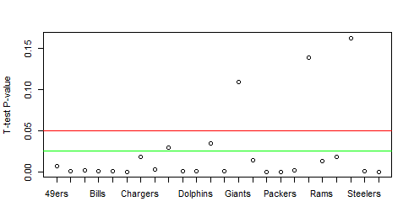
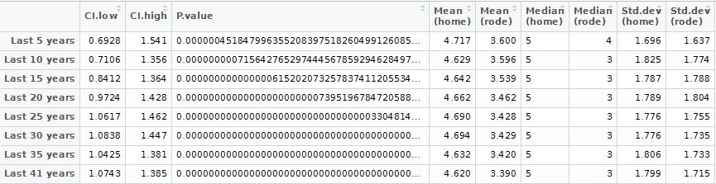
Two-tailed t-test p.values

Slide 8
(3) : “Performance and Pay” Relationships
Objective: Determine if “pay” predictors were more significant than “performance” predictors at influencing the league data sets
Methodology:
Organize the data into the same time frame for all predictors for an accurate comparison (6 years)
Create Correlation Matrices of the variables, categorize, count and plot the results (Boxplots)
Create Regression Matrices of the variables as predictors/response and categorize by r squared, count and plot the results (Boxplot)
Assess results → Note Issues

Slide 9
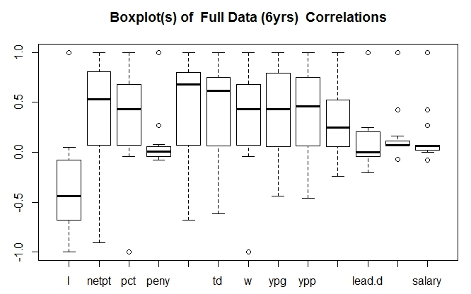
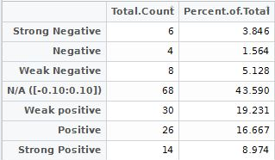
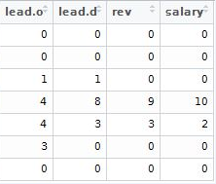

Slide 10
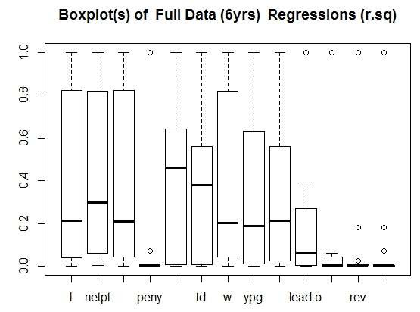
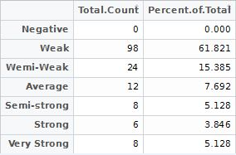
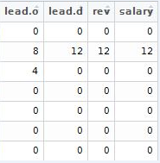

Slide 11
(4) : Effects of Rule changes on NFL (as a league)
Objective: Analyze the effect of (2) major rule change periods (1995 and 2005) and tyr to determine if they have a significant influence or not
Methodology:
Test significance (if it exists) of changes in the variables’ data before and after the rule change
Two (2) analysis techniques:
T-tests on the periods before and after the rule change (from 1 to n years)
T-tests on the periods leading up to and away from the rule change year (year by year)
The periods we used to assess larger and larger periods of time
The steps we used to counterbalance looking at simply larger time periods

Slide 12
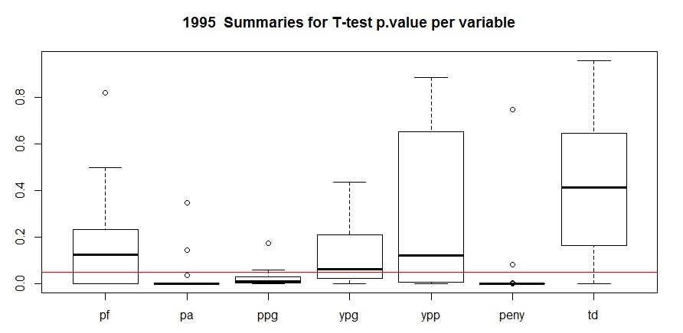

Slide 13
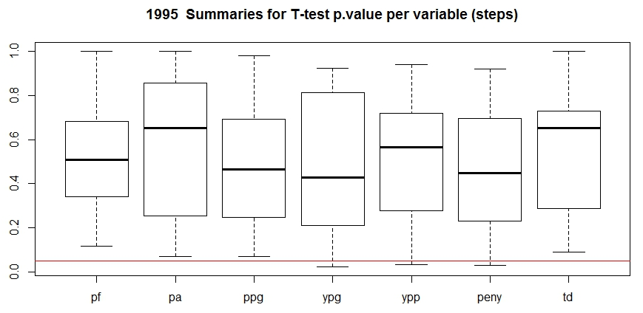

Slide 14
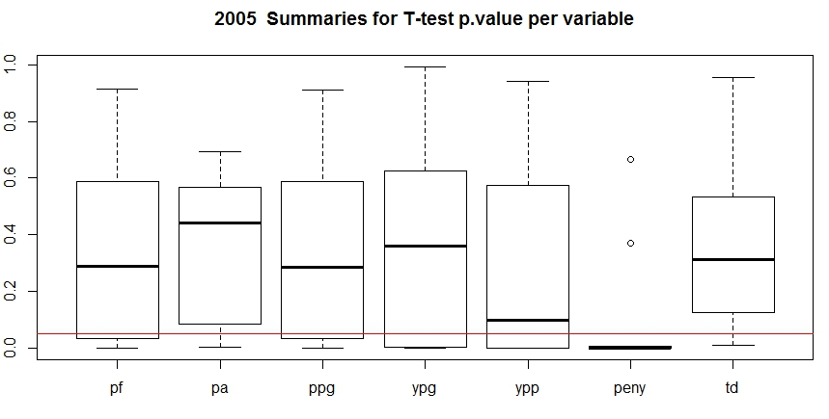

Slide 15
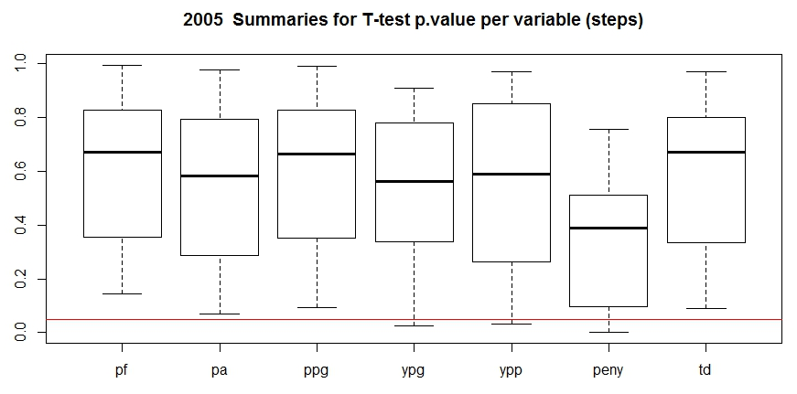

Slide 16
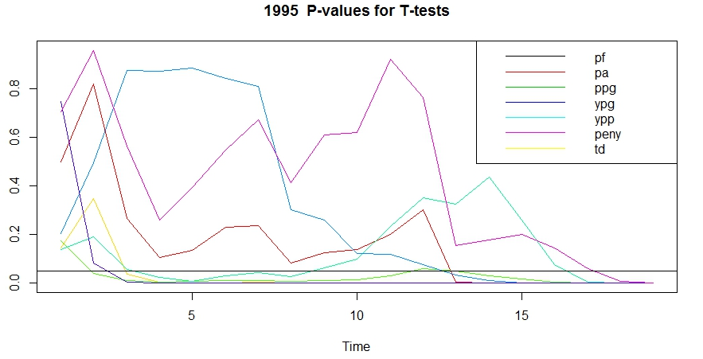

Slide 17
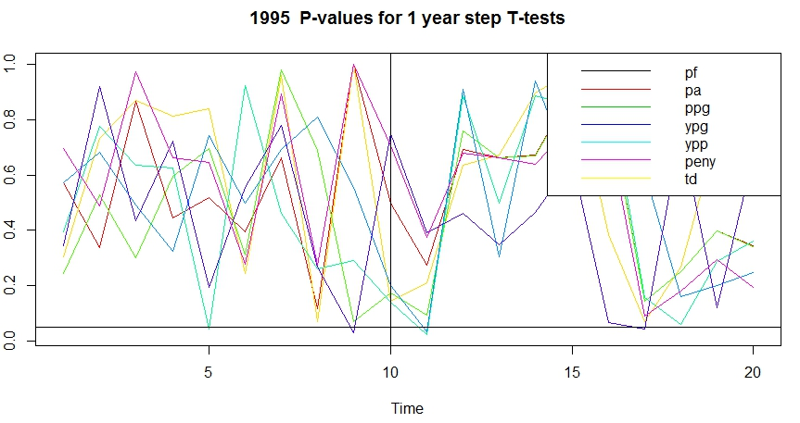

Slide 18
Analyzing the NFL
Statistical Analyses of NFL league-wide data sets
Wyatt Marciniak
Pia Om
Laramie Regalado

